Slide 1

NEW ELITE GATHERED
NEW ELITE GATHERED NEW ELITE GATHERED NEW ELITE GATHERED NEW ELITE GATHERED NEW ELITE GATHERED NEW ELITE GATHERED NEW ELITE GATHERED NEW ELITE GATHERED NEW ELITE GATHERED NEW ELITE GATHERED NEW ELITE GATHERED NEW ELITE GATHERED NEW ELITE GATHERED NEW ELITE GATHERED NEW ELITE GATHERED NEW ELITE GATHERED NEW ELITE GATHERED NEW ELITE GATHERED NEW ELITE GATHERED NEW ELITE GATHERED NEW ELITE GATHERED NEW ELITE GATHERED NEW ELITE GATHERED NEW ELITE GATHERED
NEW
ELITE GATHERED
大童第三届
金童汇高端论坛

Slide 2
NEW ELITE GATHERED
NEW ELITE GATHERED
NEW ELITE GATHERED
NEW ELITE GATHERED
【活动概况】
时间：2021年5月
地点：北京新华联丽景温泉酒店
规模：120人

Slide 3
NEW ELITE GATHERED NEW ELITE GATHERED NEW ELITE GATHERED NEW ELITE GATHERED NEW ELITE GATHERED NEW ELITE GATHERED NEW ELITE GATHERED NEW ELITE GATHERED NEW ELITE GATHERED NEW ELITE GATHERED NEW ELITE GATHERED NEW ELITE GATHERED NEW ELITE GATHERED NEW ELITE GATHERED NEW ELITE GATHERED NEW ELITE GATHERED
我们的目标客群
新生代
新保险人

Slide 4
NEW
何为新？
ELITE GATHERED

Slide 5
NEW ELITE GATHERED
NEW ELITE GATHERED
NEW ELITE GATHERED NEW ELITE GATHERED NEW ELITE GATHERED NEW ELITE GATHERED NEW ELITE GATHERED NEW ELITE GATHERED NEW ELITE GATHERED NEW ELITE GATHERED NEW ELITE GATHERED NEW ELITE GATHERED NEW ELITE GATHERED NEW ELITE GATHERED NEW ELITE GATHERED NEW ELITE GATHERED NEW ELITE GATHERED NEW ELITE GATHERED NEW ELITE GATHERED NEW ELITE GATHERED NEW ELITE GATHERED NEW ELITE GATHERED NEW ELITE GATHERED NEW ELITE GATHERED NEW ELITE GATHERED NEW ELITE GATHERED
新保险
新血液
大童新保险人
革新保险行业
大童新血液
释放新力量

Slide 6
NEW
为何新？
ELITE GATHERED

Slide 7
NEW ELITE GATHERED
NEW ELITE GATHERED
NEW ELITE GATHERED NEW ELITE GATHERED NEW ELITE GATHERED NEW ELITE GATHERED NEW ELITE GATHERED NEW ELITE GATHERED NEW ELITE GATHERED NEW ELITE GATHERED NEW ELITE GATHERED NEW ELITE GATHERED NEW ELITE GATHERED NEW ELITE GATHERED NEW ELITE GATHERED NEW ELITE GATHERED NEW ELITE GATHERED NEW ELITE GATHERED NEW ELITE GATHERED NEW ELITE GATHERED NEW ELITE GATHERED NEW ELITE GATHERED NEW ELITE GATHERED NEW ELITE GATHERED NEW ELITE GATHERED NEW ELITE GATHERED
为新生
为荣誉
为传承
要崛起
要成就
要崛起
要成就
要突破
要突破

Slide 8
NEW
如何新？
ELITE GATHERED

Slide 9
NEW ELITE GATHERED NEW ELITE GATHERED NEW ELITE GATHERED NEW ELITE GATHERED NEW ELITE GATHERED NEW ELITE GATHERED NEW ELITE GATHERED NEW ELITE GATHERED NEW ELITE GATHERED NEW ELITE GATHERED NEW ELITE GATHERED NEW ELITE GATHERED NEW ELITE GATHERED NEW ELITE GATHERED NEW ELITE GATHERED NEW ELITE GATHERED NEW ELITE GATHERED NEW ELITE GATHERED NEW ELITE GATHERED NEW ELITE GATHERED NEW ELITE GATHERED NEW ELITE GATHERED NEW ELITE GATHERED NEW ELITE GATHERED
用破茧成蝶的新生力量
与大童相伴前行
迎接新未来
2019-2021
一场蝶变
一次新生
一种力量

Slide 10
NEW ELITE GATHERED NEW ELITE GATHERED NEW ELITE GATHERED NEW ELITE GATHERED NEW ELITE GATHERED NEW ELITE GATHERED NEW ELITE GATHERED NEW ELITE GATHERED NEW ELITE GATHERED NEW ELITE GATHERED NEW ELITE GATHERED NEW ELITE GATHERED NEW ELITE GATHERED NEW ELITE GATHERED NEW ELITE GATHERED NEW ELITE GATHERED NEW ELITE GATHERED NEW ELITE GATHERED NEW ELITE GATHERED NEW ELITE GATHERED NEW ELITE GATHERED NEW ELITE GATHERED NEW ELITE GATHERED NEW ELITE GATHERED NEW ELITE GATHERED NEW ELITE GATHERED NEW ELITE GATHERED NEW ELITE GATHERED
NEW
ELITE GATHERED
2021给新保险人一场全新的论坛盛典

Slide 11
NEW ELITE GATHERED NEW ELITE GATHERED NEW ELITE GATHERED NEW ELITE GATHERED NEW ELITE GATHERED NEW ELITE GATHERED NEW ELITE GATHERED NEW ELITE GATHERED NEW ELITE GATHERED NEW ELITE GATHERED NEW ELITE GATHERED NEW ELITE GATHERED NEW ELITE GATHERED NEW ELITE GATHERED NEW ELITE GATHERED NEW ELITE GATHERED NEW ELITE GATHERED NEW ELITE GATHERED NEW ELITE GATHERED NEW ELITE GATHERED NEW ELITE GATHERED NEW ELITE GATHERED NEW ELITE GATHERED NEW ELITE GATHERED
活动主题
新
生
无限
童
向
而
行
主题释义：
1-肆意生长，不受限制的新生代们，以自己年轻的力量在大童新保险行业里一撅而起。
2-新生代们朝着大童奔赴而来，为了同一个未来而聚力向前。
3-大童不断注入新鲜血液，以更聚势的力量，创造荣耀的明天。

Slide 12
NEW ELITE GATHERED
NEW ELITE GATHERED
NEW ELITE GATHERED NEW ELITE GATHERED NEW ELITE GATHERED NEW ELITE GATHERED NEW ELITE GATHERED NEW ELITE GATHERED NEW ELITE GATHERED NEW ELITE GATHERED NEW ELITE GATHERED NEW ELITE GATHERED NEW ELITE GATHERED NEW ELITE GATHERED NEW ELITE GATHERED NEW ELITE GATHERED NEW ELITE GATHERED NEW ELITE GATHERED NEW ELITE GATHERED NEW ELITE GATHERED NEW ELITE GATHERED NEW ELITE GATHERED NEW ELITE GATHERED NEW ELITE GATHERED NEW ELITE GATHERED NEW ELITE GATHERED
备选主题
童新引力 大有可为
无限新生 童向而行
度势立新 向上童行
焕新 · 前行
新 · 不止所见
01
02
03
04
05

Slide 13

主视觉设计1

Slide 14

主视觉设计2

Slide 15

主视觉设计3

Slide 16

主视觉设计4

Slide 17
空间规划
新生力量
·序厅
无限生长
·舞台
全新的体验和感受
以年轻力量感染新生代
在舞台上尽情演绎自己
看见无限生长的大童未来

Slide 18
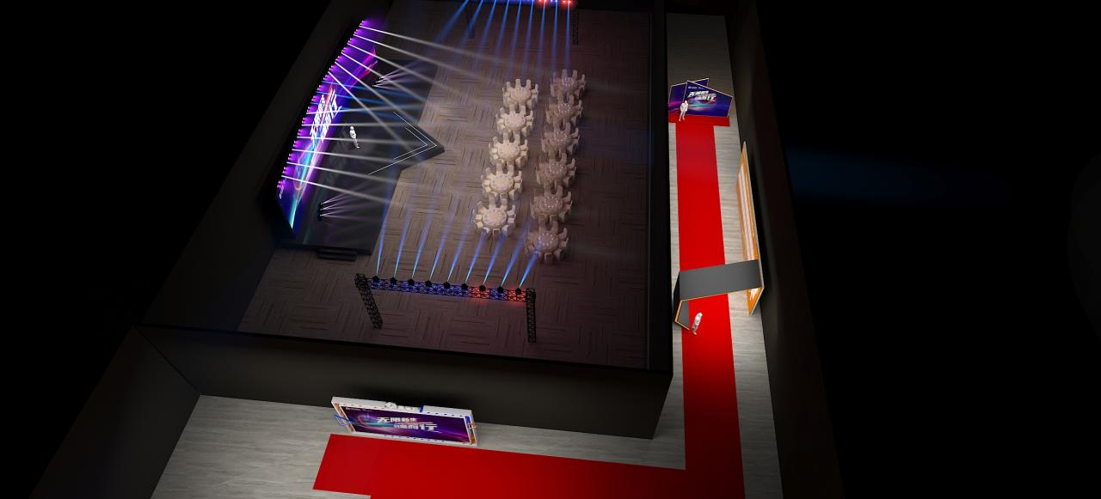
场地布局图（晚宴）
合影区
舞台区
晚宴圆桌
人物展示榜
来宾动线
签到区

Slide 19
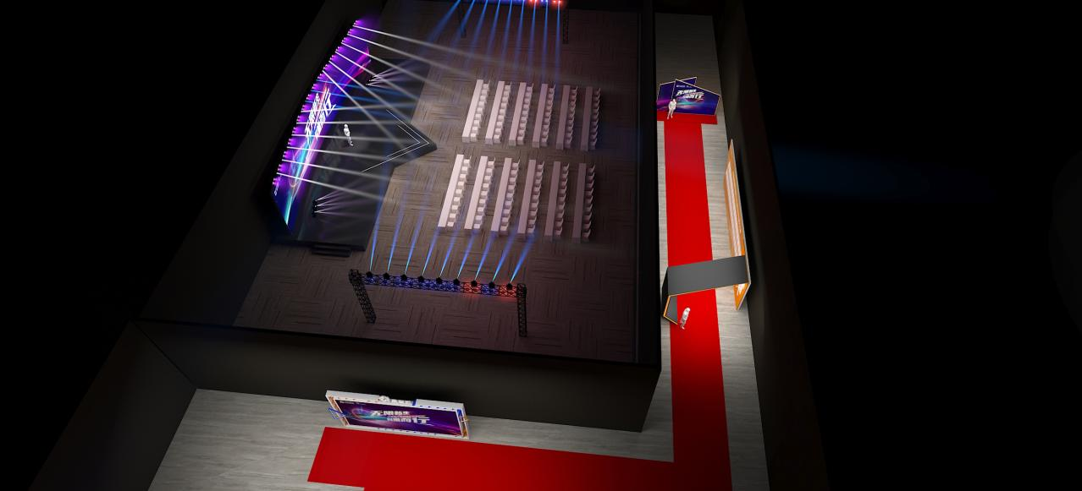
场地布局图（会议）
会议课桌

Slide 20

签到区

Slide 21

通道/门头

Slide 22

人物展示区

Slide 23

合影区

Slide 24

舞台

Slide 25

舞台

Slide 26
内容规划
匠心之道
DAY 01
新星之力
DAY 01
焕新之路
DAY 02
09:00-09:10
09:10-10:40
11:00-12:00
12:00-13:30
13:30-14:20
14:20-15:10
15:30-17:00
开幕式
新星圆桌访谈
三人行必有我师（一）
快乐午餐
三人行必有我师（二）
三人行必有我师（三）
导师小会场
18:00-19:00
19:00-20:30
荣誉红毯
颁奖盛典
09:00-09:45
09:45-10:30
10:50-12:00
12:00-12:15
12:15-14:00
优秀新星分享
优秀合伙人分享
论坛主题演讲
论坛闭幕式
快乐午餐及返程

Slide 27
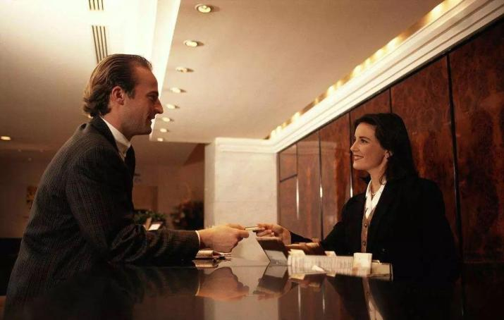
NEW ELITE GATHERED
NEW ELITE GATHERED
NEW ELITE GATHERED NEW ELITE GATHERED NEW ELITE GATHERED NEW ELITE GATHERED NEW ELITE GATHERED NEW ELITE GATHERED NEW ELITE GATHERED NEW ELITE GATHERED NEW ELITE GATHERED NEW ELITE GATHERED NEW ELITE GATHERED NEW ELITE GATHERED NEW ELITE GATHERED NEW ELITE GATHERED NEW ELITE GATHERED NEW ELITE GATHERED NEW ELITE GATHERED NEW ELITE GATHERED NEW ELITE GATHERED NEW ELITE GATHERED NEW ELITE GATHERED NEW ELITE GATHERED NEW ELITE GATHERED NEW ELITE GATHERED
嘉宾入住酒店 CHECK IN
Day 1前一日16:00前
所有来宾抵达酒店后
至酒店前台大童签到处
进行签到并领取房卡

Slide 28
NEW ELITE GATHERED NEW ELITE GATHERED NEW ELITE GATHERED NEW ELITE GATHERED NEW ELITE GATHERED NEW ELITE GATHERED NEW ELITE GATHERED NEW ELITE GATHERED NEW ELITE GATHERED NEW ELITE GATHERED NEW ELITE GATHERED NEW ELITE GATHERED NEW ELITE GATHERED NEW ELITE GATHERED NEW ELITE GATHERED NEW ELITE GATHERED NEW ELITE GATHERED NEW ELITE GATHERED NEW ELITE GATHERED NEW ELITE GATHERED NEW ELITE GATHERED NEW ELITE GATHERED NEW ELITE GATHERED NEW ELITE GATHERED
匠心之道
NEW
DAY 01
ELITE GATHERED

Slide 29
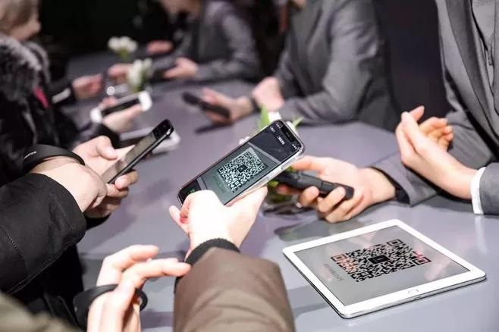
NEW ELITE GATHERED
NEW ELITE GATHERED
NEW ELITE GATHERED NEW ELITE GATHERED NEW ELITE GATHERED NEW ELITE GATHERED NEW ELITE GATHERED NEW ELITE GATHERED NEW ELITE GATHERED NEW ELITE GATHERED NEW ELITE GATHERED NEW ELITE GATHERED NEW ELITE GATHERED NEW ELITE GATHERED NEW ELITE GATHERED NEW ELITE GATHERED NEW ELITE GATHERED NEW ELITE GATHERED NEW ELITE GATHERED NEW ELITE GATHERED NEW ELITE GATHERED NEW ELITE GATHERED NEW ELITE GATHERED NEW ELITE GATHERED NEW ELITE GATHERED NEW ELITE GATHERED
来宾签到
08:00-09:00
扫码签到
嘉宾快速便捷进行扫码签到
随后进入会入座

Slide 30

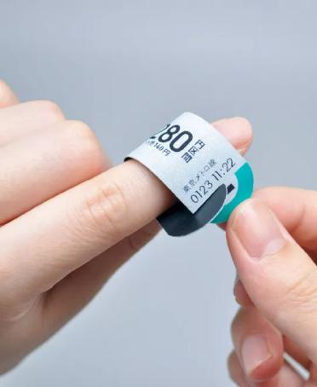
NEW ELITE GATHERED
NEW ELITE GATHERED
NEW ELITE GATHERED NEW ELITE GATHERED NEW ELITE GATHERED NEW ELITE GATHERED NEW ELITE GATHERED NEW ELITE GATHERED NEW ELITE GATHERED NEW ELITE GATHERED NEW ELITE GATHERED NEW ELITE GATHERED NEW ELITE GATHERED NEW ELITE GATHERED NEW ELITE GATHERED NEW ELITE GATHERED NEW ELITE GATHERED NEW ELITE GATHERED NEW ELITE GATHERED NEW ELITE GATHERED NEW ELITE GATHERED NEW ELITE GATHERED NEW ELITE GATHERED NEW ELITE GATHERED NEW ELITE GATHERED NEW ELITE GATHERED
嘉宾身份标识
定制匠心指环
为每一位来并送上身份标识
（指环内容包含：座位信息/云相册二维码/会议主题等）

Slide 31

NEW ELITE GATHERED
NEW ELITE GATHERED
NEW ELITE GATHERED NEW ELITE GATHERED NEW ELITE GATHERED NEW ELITE GATHERED NEW ELITE GATHERED NEW ELITE GATHERED NEW ELITE GATHERED NEW ELITE GATHERED NEW ELITE GATHERED NEW ELITE GATHERED NEW ELITE GATHERED NEW ELITE GATHERED NEW ELITE GATHERED NEW ELITE GATHERED NEW ELITE GATHERED NEW ELITE GATHERED NEW ELITE GATHERED NEW ELITE GATHERED NEW ELITE GATHERED NEW ELITE GATHERED NEW ELITE GATHERED NEW ELITE GATHERED NEW ELITE GATHERED NEW ELITE GATHERED
开幕仪式
09:00-09:10
全息风扇仪式
1-领导启动全息按钮
2-全息风扇启动，露出本次大会主题

Slide 32

NEW ELITE GATHERED
NEW ELITE GATHERED
NEW ELITE GATHERED NEW ELITE GATHERED NEW ELITE GATHERED NEW ELITE GATHERED NEW ELITE GATHERED NEW ELITE GATHERED NEW ELITE GATHERED NEW ELITE GATHERED NEW ELITE GATHERED NEW ELITE GATHERED NEW ELITE GATHERED NEW ELITE GATHERED NEW ELITE GATHERED NEW ELITE GATHERED NEW ELITE GATHERED NEW ELITE GATHERED NEW ELITE GATHERED NEW ELITE GATHERED NEW ELITE GATHERED NEW ELITE GATHERED NEW ELITE GATHERED NEW ELITE GATHERED NEW ELITE GATHERED NEW ELITE GATHERED
新星圆桌访谈
09:10-10:40
相关领导以圆桌论坛的形式
在舞台上进行相关议题的探讨
*加班座位采用沙发座椅，以半包围形式入座

Slide 33

NEW ELITE GATHERED
NEW ELITE GATHERED
NEW ELITE GATHERED NEW ELITE GATHERED NEW ELITE GATHERED NEW ELITE GATHERED NEW ELITE GATHERED NEW ELITE GATHERED NEW ELITE GATHERED NEW ELITE GATHERED NEW ELITE GATHERED NEW ELITE GATHERED NEW ELITE GATHERED NEW ELITE GATHERED NEW ELITE GATHERED NEW ELITE GATHERED NEW ELITE GATHERED NEW ELITE GATHERED NEW ELITE GATHERED NEW ELITE GATHERED NEW ELITE GATHERED NEW ELITE GATHERED NEW ELITE GATHERED NEW ELITE GATHERED NEW ELITE GATHERED NEW ELITE GATHERED
三人行必有我师
11:00-12:00（一）
13:30-14:20（二）
14:20-15:10（三）
相关代表上台
进行主题演讲
*大屏配合PPT/KEYNOTE播放

Slide 34

NEW ELITE GATHERED
NEW ELITE GATHERED
NEW ELITE GATHERED NEW ELITE GATHERED NEW ELITE GATHERED NEW ELITE GATHERED NEW ELITE GATHERED NEW ELITE GATHERED NEW ELITE GATHERED NEW ELITE GATHERED NEW ELITE GATHERED NEW ELITE GATHERED NEW ELITE GATHERED NEW ELITE GATHERED NEW ELITE GATHERED NEW ELITE GATHERED NEW ELITE GATHERED NEW ELITE GATHERED NEW ELITE GATHERED NEW ELITE GATHERED NEW ELITE GATHERED NEW ELITE GATHERED NEW ELITE GATHERED NEW ELITE GATHERED NEW ELITE GATHERED NEW ELITE GATHERED
导师小会场
15:30-17:00
相关导师代表上台
进行主题演讲
*大屏配合PPT/KEYNOTE播放

Slide 35
NEW ELITE GATHERED NEW ELITE GATHERED NEW ELITE GATHERED NEW ELITE GATHERED NEW ELITE GATHERED NEW ELITE GATHERED NEW ELITE GATHERED NEW ELITE GATHERED NEW ELITE GATHERED NEW ELITE GATHERED NEW ELITE GATHERED NEW ELITE GATHERED NEW ELITE GATHERED NEW ELITE GATHERED NEW ELITE GATHERED NEW ELITE GATHERED NEW ELITE GATHERED NEW ELITE GATHERED NEW ELITE GATHERED NEW ELITE GATHERED NEW ELITE GATHERED NEW ELITE GATHERED NEW ELITE GATHERED NEW ELITE GATHERED
新星之力
NEW
DAY 01
ELITE GATHERED

Slide 36

NEW ELITE GATHERED
NEW ELITE GATHERED
NEW ELITE GATHERED NEW ELITE GATHERED NEW ELITE GATHERED NEW ELITE GATHERED NEW ELITE GATHERED NEW ELITE GATHERED NEW ELITE GATHERED NEW ELITE GATHERED NEW ELITE GATHERED NEW ELITE GATHERED NEW ELITE GATHERED NEW ELITE GATHERED NEW ELITE GATHERED NEW ELITE GATHERED NEW ELITE GATHERED NEW ELITE GATHERED NEW ELITE GATHERED NEW ELITE GATHERED NEW ELITE GATHERED NEW ELITE GATHERED NEW ELITE GATHERED NEW ELITE GATHERED NEW ELITE GATHERED NEW ELITE GATHERED
荣誉红毯
18:00-19:00
来宾身穿礼服进行红毯秀
摄影师用镜头记录大童新星璀璨的身影

Slide 37
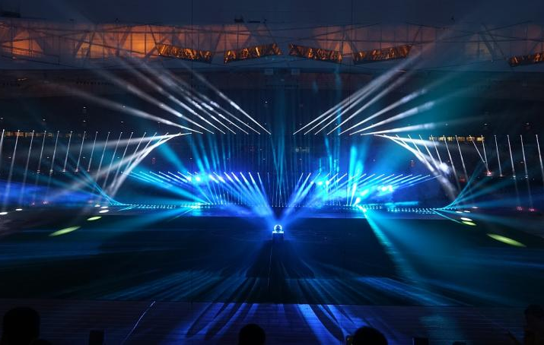
NEW ELITE GATHERED
NEW ELITE GATHERED
NEW ELITE GATHERED NEW ELITE GATHERED NEW ELITE GATHERED NEW ELITE GATHERED NEW ELITE GATHERED NEW ELITE GATHERED NEW ELITE GATHERED NEW ELITE GATHERED NEW ELITE GATHERED NEW ELITE GATHERED NEW ELITE GATHERED NEW ELITE GATHERED NEW ELITE GATHERED NEW ELITE GATHERED NEW ELITE GATHERED NEW ELITE GATHERED NEW ELITE GATHERED NEW ELITE GATHERED NEW ELITE GATHERED NEW ELITE GATHERED NEW ELITE GATHERED NEW ELITE GATHERED NEW ELITE GATHERED NEW ELITE GATHERED
开场倒计时/灯光秀
19:00-19:00
30s灯光秀+10s倒计时
渲染开场氛围
将来宾目光聚焦至舞台上

Slide 38


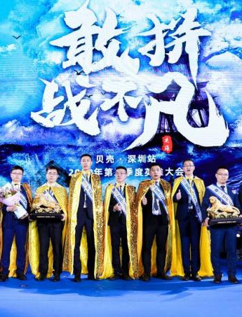
NEW ELITE GATHERED
NEW ELITE GATHERED
NEW ELITE GATHERED NEW ELITE GATHERED NEW ELITE GATHERED NEW ELITE GATHERED NEW ELITE GATHERED NEW ELITE GATHERED NEW ELITE GATHERED NEW ELITE GATHERED NEW ELITE GATHERED NEW ELITE GATHERED NEW ELITE GATHERED NEW ELITE GATHERED NEW ELITE GATHERED NEW ELITE GATHERED NEW ELITE GATHERED NEW ELITE GATHERED NEW ELITE GATHERED NEW ELITE GATHERED NEW ELITE GATHERED NEW ELITE GATHERED NEW ELITE GATHERED NEW ELITE GATHERED NEW ELITE GATHERED NEW ELITE GATHERED
颁奖流程
19:00-20:30
1-公布获奖名单
2-获奖人员出场
3-颁奖/合影/感言

Slide 39
NEW ELITE GATHERED
NEW ELITE GATHERED
NEW ELITE GATHERED NEW ELITE GATHERED NEW ELITE GATHERED NEW ELITE GATHERED NEW ELITE GATHERED NEW ELITE GATHERED NEW ELITE GATHERED NEW ELITE GATHERED NEW ELITE GATHERED NEW ELITE GATHERED NEW ELITE GATHERED NEW ELITE GATHERED NEW ELITE GATHERED NEW ELITE GATHERED NEW ELITE GATHERED NEW ELITE GATHERED NEW ELITE GATHERED NEW ELITE GATHERED NEW ELITE GATHERED NEW ELITE GATHERED NEW ELITE GATHERED NEW ELITE GATHERED NEW ELITE GATHERED NEW ELITE GATHERED
获奖人员出场形式
19:00-20:30
在背景音乐和灯光的渲染下
获奖者从舞台两侧闪亮登场
沿着舞台前V型台站成V字队列

Slide 40

NEW ELITE GATHERED
NEW ELITE GATHERED
NEW ELITE GATHERED NEW ELITE GATHERED NEW ELITE GATHERED NEW ELITE GATHERED NEW ELITE GATHERED NEW ELITE GATHERED NEW ELITE GATHERED NEW ELITE GATHERED NEW ELITE GATHERED NEW ELITE GATHERED NEW ELITE GATHERED NEW ELITE GATHERED NEW ELITE GATHERED NEW ELITE GATHERED NEW ELITE GATHERED NEW ELITE GATHERED NEW ELITE GATHERED NEW ELITE GATHERED NEW ELITE GATHERED NEW ELITE GATHERED NEW ELITE GATHERED NEW ELITE GATHERED NEW ELITE GATHERED NEW ELITE GATHERED
新星晚宴
19:00-20:30
1-公布获奖名单
2-获奖人员出场
3-颁奖/合影/感言

Slide 41
NEW ELITE GATHERED NEW ELITE GATHERED NEW ELITE GATHERED NEW ELITE GATHERED NEW ELITE GATHERED NEW ELITE GATHERED NEW ELITE GATHERED NEW ELITE GATHERED NEW ELITE GATHERED NEW ELITE GATHERED NEW ELITE GATHERED NEW ELITE GATHERED NEW ELITE GATHERED NEW ELITE GATHERED NEW ELITE GATHERED NEW ELITE GATHERED NEW ELITE GATHERED NEW ELITE GATHERED NEW ELITE GATHERED NEW ELITE GATHERED NEW ELITE GATHERED NEW ELITE GATHERED NEW ELITE GATHERED NEW ELITE GATHERED
焕新之路
NEW
DAY 02
ELITE GATHERED

Slide 42
NEW ELITE GATHERED
NEW ELITE GATHERED
NEW ELITE GATHERED NEW ELITE GATHERED NEW ELITE GATHERED NEW ELITE GATHERED NEW ELITE GATHERED NEW ELITE GATHERED NEW ELITE GATHERED NEW ELITE GATHERED NEW ELITE GATHERED NEW ELITE GATHERED NEW ELITE GATHERED NEW ELITE GATHERED NEW ELITE GATHERED NEW ELITE GATHERED NEW ELITE GATHERED NEW ELITE GATHERED NEW ELITE GATHERED NEW ELITE GATHERED NEW ELITE GATHERED NEW ELITE GATHERED NEW ELITE GATHERED NEW ELITE GATHERED NEW ELITE GATHERED NEW ELITE GATHERED
来宾签到
08:00-09:00
扫码签到
嘉宾快速便捷进行扫码签到
随后进入会入座

Slide 43
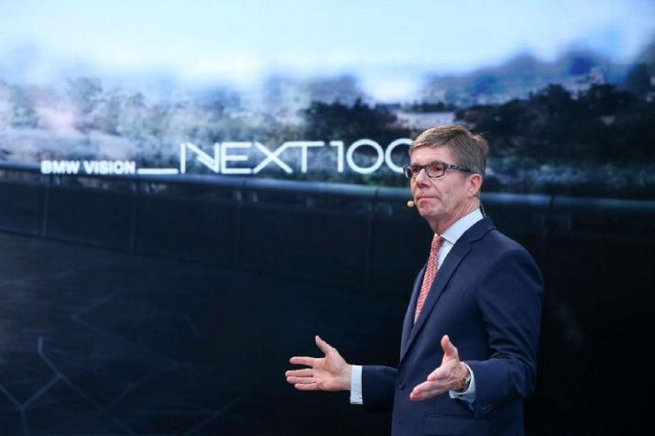
NEW ELITE GATHERED
NEW ELITE GATHERED
NEW ELITE GATHERED NEW ELITE GATHERED NEW ELITE GATHERED NEW ELITE GATHERED NEW ELITE GATHERED NEW ELITE GATHERED NEW ELITE GATHERED NEW ELITE GATHERED NEW ELITE GATHERED NEW ELITE GATHERED NEW ELITE GATHERED NEW ELITE GATHERED NEW ELITE GATHERED NEW ELITE GATHERED NEW ELITE GATHERED NEW ELITE GATHERED NEW ELITE GATHERED NEW ELITE GATHERED NEW ELITE GATHERED NEW ELITE GATHERED NEW ELITE GATHERED NEW ELITE GATHERED NEW ELITE GATHERED NEW ELITE GATHERED
优秀新星分享
09:00-09:45
优秀合伙人分享
09:45-10:30
论坛主题演讲
10:52-12:00

Slide 44

NEW ELITE GATHERED
NEW ELITE GATHERED
NEW ELITE GATHERED NEW ELITE GATHERED NEW ELITE GATHERED NEW ELITE GATHERED NEW ELITE GATHERED NEW ELITE GATHERED NEW ELITE GATHERED NEW ELITE GATHERED NEW ELITE GATHERED NEW ELITE GATHERED NEW ELITE GATHERED NEW ELITE GATHERED NEW ELITE GATHERED NEW ELITE GATHERED NEW ELITE GATHERED NEW ELITE GATHERED NEW ELITE GATHERED NEW ELITE GATHERED NEW ELITE GATHERED NEW ELITE GATHERED NEW ELITE GATHERED NEW ELITE GATHERED NEW ELITE GATHERED NEW ELITE GATHERED
闭幕仪式
12:00-12:15
推杆仪式
邀请领导上台一起推杆
启动台前的卷轴露出下一站会议举办的城市地点

Slide 45
NEW ELITE GATHERED NEW ELITE GATHERED NEW ELITE GATHERED NEW ELITE GATHERED NEW ELITE GATHERED NEW ELITE GATHERED NEW ELITE GATHERED NEW ELITE GATHERED NEW ELITE GATHERED NEW ELITE GATHERED NEW ELITE GATHERED NEW ELITE GATHERED NEW ELITE GATHERED NEW ELITE GATHERED NEW ELITE GATHERED NEW ELITE GATHERED NEW ELITE GATHERED NEW ELITE GATHERED NEW ELITE GATHERED NEW ELITE GATHERED NEW ELITE GATHERED NEW ELITE GATHERED NEW ELITE GATHERED NEW ELITE GATHERED NEW ELITE GATHERED NEW ELITE GATHERED NEW ELITE GATHERED NEW ELITE GATHERED
NEW
ELITE GATHERED
宣传规划

Slide 46


NEW ELITE GATHERED NEW ELITE GATHERED NEW ELITE GATHERED NEW ELITE GATHERED NEW ELITE GATHERED NEW ELITE GATHERED NEW ELITE GATHERED NEW ELITE GATHERED NEW ELITE GATHERED NEW ELITE GATHERED NEW ELITE GATHERED NEW ELITE GATHERED NEW ELITE GATHERED NEW ELITE GATHERED NEW ELITE GATHERED NEW ELITE GATHERED
嘉宾邀请函
形式一 长图邀请函
形式二 H5邀请函

Slide 47


NEW ELITE GATHERED NEW ELITE GATHERED NEW ELITE GATHERED NEW ELITE GATHERED NEW ELITE GATHERED NEW ELITE GATHERED NEW ELITE GATHERED NEW ELITE GATHERED NEW ELITE GATHERED NEW ELITE GATHERED NEW ELITE GATHERED NEW ELITE GATHERED NEW ELITE GATHERED NEW ELITE GATHERED NEW ELITE GATHERED NEW ELITE GATHERED
倒计时海报
风格一
倒计时天数+论坛主题文字
风格二
倒计时天数+优秀新星人物剪影

Slide 48

NEW ELITE GATHERED NEW ELITE GATHERED NEW ELITE GATHERED NEW ELITE GATHERED NEW ELITE GATHERED NEW ELITE GATHERED NEW ELITE GATHERED NEW ELITE GATHERED NEW ELITE GATHERED NEW ELITE GATHERED NEW ELITE GATHERED NEW ELITE GATHERED NEW ELITE GATHERED NEW ELITE GATHERED NEW ELITE GATHERED NEW ELITE GATHERED
15s花絮视频
活动期间
每日发布一条15s现场花絮视频
供来宾自发的发布朋友圈
对外宣传本次活动

Slide 49
NEW ELITE GATHERED NEW ELITE GATHERED NEW ELITE GATHERED NEW ELITE GATHERED NEW ELITE GATHERED NEW ELITE GATHERED NEW ELITE GATHERED NEW ELITE GATHERED NEW ELITE GATHERED NEW ELITE GATHERED NEW ELITE GATHERED NEW ELITE GATHERED NEW ELITE GATHERED NEW ELITE GATHERED NEW ELITE GATHERED NEW ELITE GATHERED NEW ELITE GATHERED NEW ELITE GATHERED NEW ELITE GATHERED NEW ELITE GATHERED NEW ELITE GATHERED NEW ELITE GATHERED NEW ELITE GATHERED NEW ELITE GATHERED NEW ELITE GATHERED NEW ELITE GATHERED NEW ELITE GATHERED NEW ELITE GATHERED
NEW
ELITE GATHERED
执行细节

Slide 50




设计延展
桌签
手卡
麦标
指引牌

Slide 51

嘉宾证

Slide 52




奖杯推荐

Slide 53


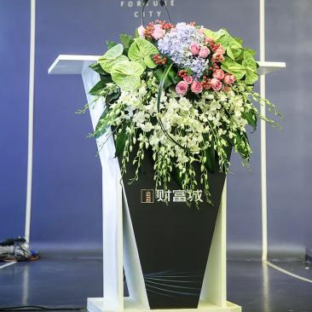
鲜花氛围
圆桌桌花
论坛茶几花
讲台花

Slide 54



鲜花花束

Slide 55

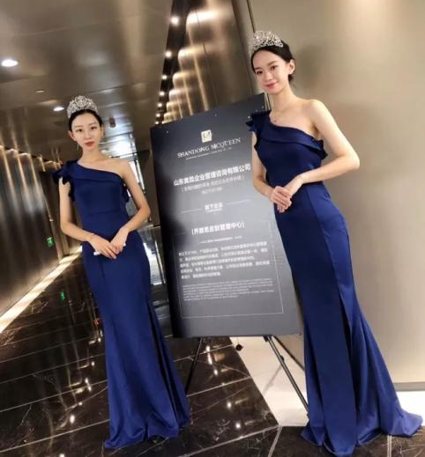
礼仪服装推荐

Slide 56
技术支持
云端摄影师 快速共享
10秒视频 实时传送
10
5
10
秒
分
秒
专业摄影
极速修片
专业摄影
10秒即可在手机端获取专业摄影师拍的照片
拍照后5分钟即可在手机端获得经过数码师精修后的照片
现场剪辑10秒短视频，为后期宣传储备素材

Slide 57
项目推进管理
活动前15天
活动前1周
活动前3天
活动当天
方案修改
项目内容推进
执行细节确定
执行手册
进场搭建现场协调
项目进行
意见反馈方案修改
场地协调
邀请启动
物料采买
搭建验收
报价确认
设计创意确定
物料制作
流程确认
现场彩排
签到方式确定
Video制作
会前会议
日程规划确定
Keynote制作
物料制作

Slide 58
应急预案
展示体验、嘉宾人员
可疑人与物 |  | 火灾、火情 |  | 伤员、危重病人 |  | 展示物、设备损坏
迅速联系区域负责人，按指示处理。 特别注意不要引起可疑人员或者物品的注意。 |  | 如遇火情要立即采取有效的扑救措施，然后迅速联系区域负责人。 预先确认灭火器位置及安全通道等方向。 |  | 如遇伤员、危重病人要先联系区域负责人，按指示处理。 急救药品提前准备，急救地点提前确认。 |  | 如遇展台、展示物破损、设备故障、需先联系区域负责人，按指示处理。 注意不要触及破损处
现场工作人员，发现人、各区域负责人员、应急管理预案、大会秘书处
分工明确，镇定指挥
及时疏散人员及物资，维持秩序，保障后续活动照常进行

Slide 59
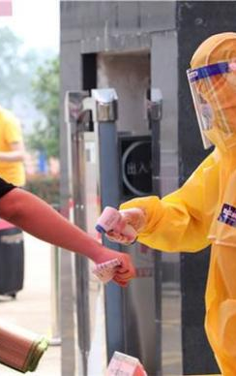
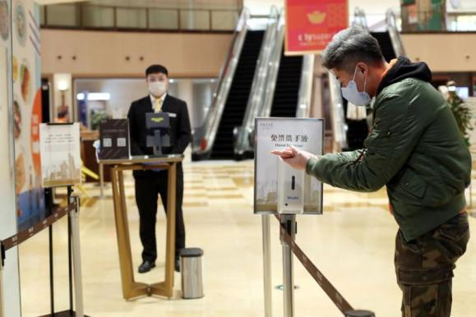

防疫预案
根据市、区领导指示精神,为确保本次活动期间不发生新型冠状病毒感染及传播问题,确保所有人员身体健康。特成立防疫小组，认真做好防疫工作，并准备卫生防疫包。

Slide 60
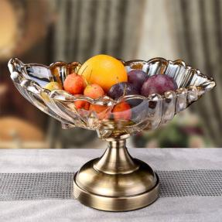

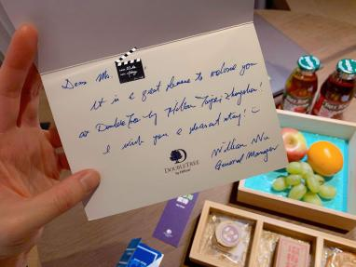
客房布置
果盘
健康防疫包
温馨提示卡
仅供参考，具体以酒店提供为准。

Slide 61
NEW ELITE GATHERED
NEW ELITE GATHERED NEW ELITE GATHERED NEW ELITE GATHERED NEW ELITE GATHERED NEW ELITE GATHERED NEW ELITE GATHERED NEW ELITE GATHERED NEW ELITE GATHERED NEW ELITE GATHERED NEW ELITE GATHERED NEW ELITE GATHERED NEW ELITE GATHERED NEW ELITE GATHERED NEW ELITE GATHERED NEW ELITE GATHERED NEW ELITE GATHERED NEW ELITE GATHERED NEW ELITE GATHERED NEW ELITE GATHERED NEW ELITE GATHERED NEW ELITE GATHERED NEW ELITE GATHERED NEW ELITE GATHERED NEW ELITE GATHERED
THANKS
大童第三届
金童汇高端论坛

