Slide 1


花点心思
LET`S 樱 JOY
2023地产项目春天樱花节主题活动
#2023
Spring Day

Slide 2


SPRING IS COMING SPRING IS COMING SPRING IS COMING SPRING IS COMING
目录
01 …………… 活动概述
02 …………… 氛围包装
03 …………… 活动内容
SPRING IS COMING SPRING IS COMING SPRING IS COMING SPRING IS COMING

Slide 3
SPRING IS COMING SPRING IS COMING SPRING IS COMING SPRING IS COMING
01
活动概况
LET`S 樱 JOY
2023年樱花节主题活动方案
SPRING IS COMING SPRING IS COMING SPRING IS COMING SPRING IS COMING

Slide 4

SPRING IS COMING SPRING IS COMING SPRING IS COMING SPRING IS COMING
策略思考
LIFE OF SSPRING
三月，世界默契地开启了粉色滤镜
带你用吃喝玩乐的方式赏樱花
这个春天，Let’s “樱”joy！
SPRING IS COMING SPRING IS COMING SPRING IS COMING SPRING IS COMING

Slide 5

SPRING IS COMING SPRING IS COMING SPRING IS COMING SPRING IS COMING
活动概述
活动概述
Methods overview
花点心思 LET`S 樱 JOY —创意樱花节主题嘉年华
时间 / Time ： 2023年3月-5月（待定）
地点/ Location ：项目销售中心或商场
人数/ Number ：1000人
活动色调/COLOUR SYSTEN：白色+粉色
SPRING IS COMING SPRING IS COMING SPRING IS COMING SPRING IS COMING

Slide 6

SPRING IS COMING SPRING IS COMING SPRING IS COMING SPRING IS COMING
活动目的
借助春日樱花节节点，营造热烈的节日氛围，吸引客户，延长客户在营销中心的滞留时间，增进客户对项目的了解，拉近与客户的感情。
凭借丰富多彩的活动内容，满足客户视觉、味觉的多重享受，让客户度过一个轻松愉悦的下午茶时光。
通过打造创意十足的活动氛围，为客户提供精致的服务，让客户感受到项目的贴心与诚意，从而最大程度地促成项目成交。
SPRING IS COMING SPRING IS COMING SPRING IS COMING SPRING IS COMING

Slide 7
SPRING IS COMING SPRING IS COMING SPRING IS COMING SPRING IS COMING
樱 JOY市集-春集
樱运而生-祈福
与春日代言的主理人相遇 一起享受樱花的鲜活与明媚。
樱火之声-春乐
得心樱手-互动
樱JOY限定-美食
SPRING IS COMING SPRING IS COMING SPRING IS COMING SPRING IS COMING

Slide 8
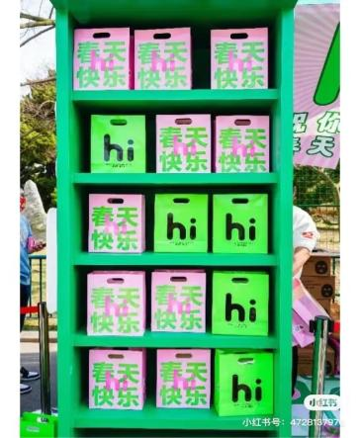
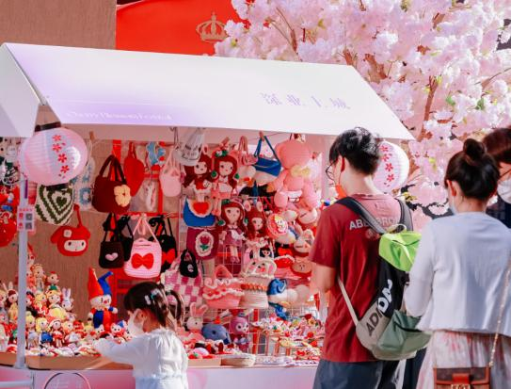
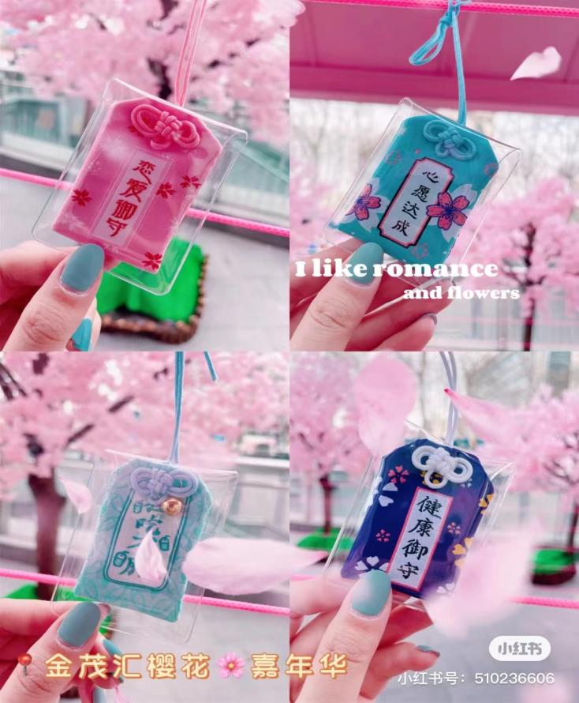
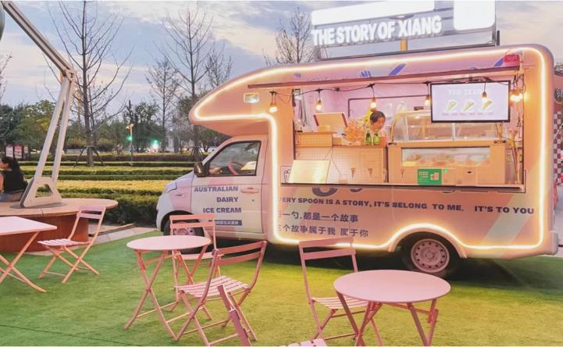
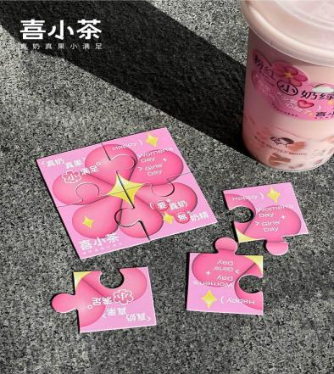
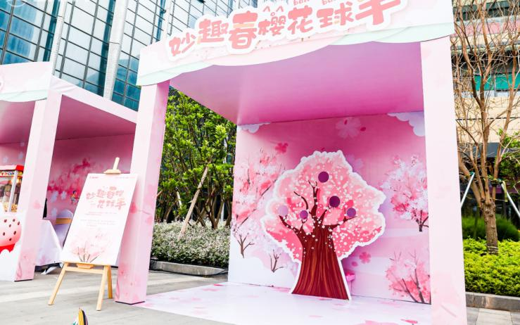
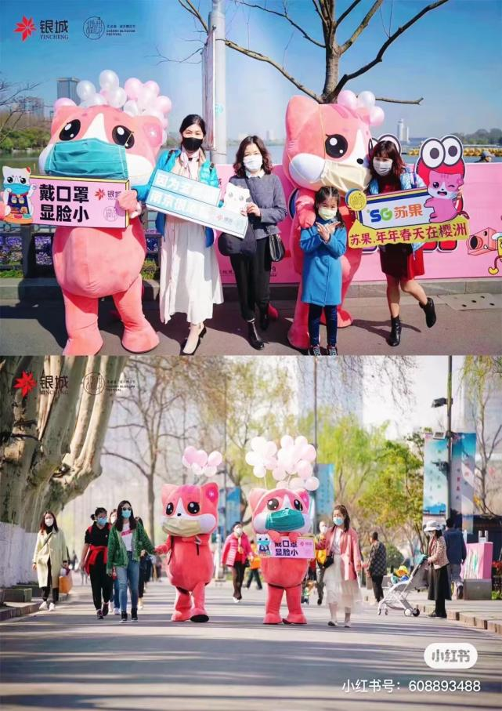
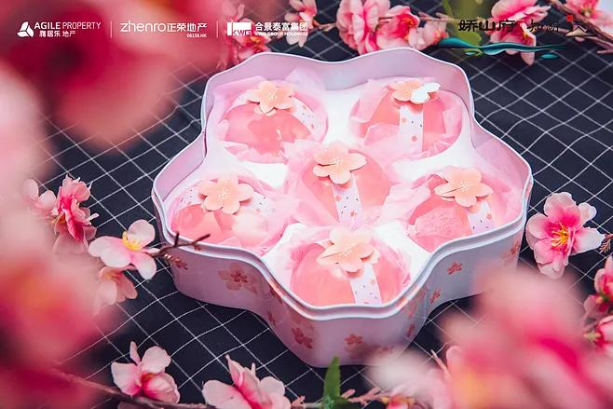
这个春天，Let’s “樱”joy！
SPRING IS COMING SPRING IS COMING SPRING IS COMING SPRING IS COMING
樱花迅游、樱花树下音乐派对、网红寺庙御守祈福、得心樱手互动挑战
还有仙女粉遍布每个角落的樱花市集
手拿弥漫甜蜜浪漫的樱花冰激凌等各种美食
一起用粉色打开2023年的春季吧
SPRING IS COMING SPRING IS COMING SPRING IS COMING SPRING IS COMING

Slide 9
SPRING IS COMING SPRING IS COMING SPRING IS COMING SPRING IS COMING
02
氛围包装
LET`S 樱 JOY
2023年樱花节主题活动方案
SPRING IS COMING SPRING IS COMING SPRING IS COMING SPRING IS COMING

Slide 10
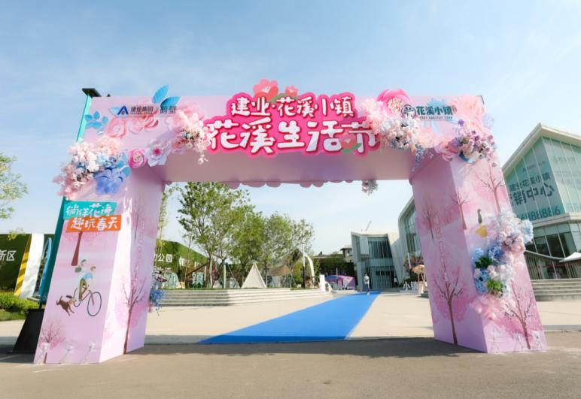
主题拱门
SPRING IS COMING SPRING IS COMING SPRING IS COMING SPRING IS COMING
整体布置主题拱门，主要以樱花粉为主，搭配花艺包装，整个活动充满了又萌又甜的春日气息。
SPRING IS COMING SPRING IS COMING SPRING IS COMING SPRING IS COMING

Slide 11
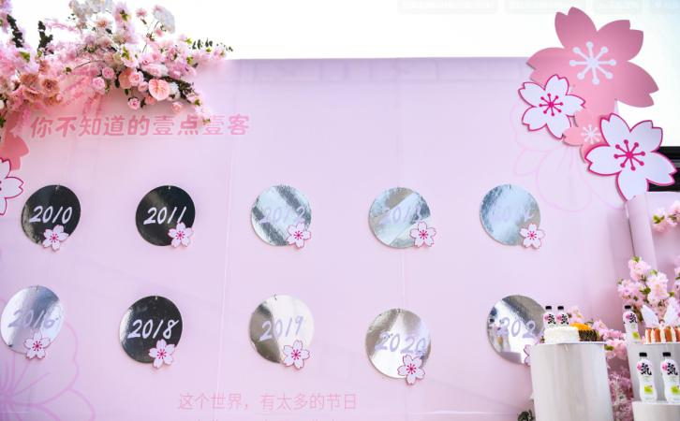
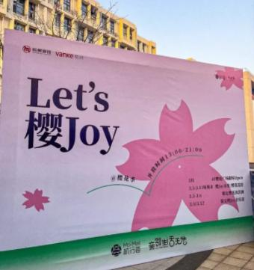
外场宣传主题合影区
SPRING IS COMING SPRING IS COMING SPRING IS COMING SPRING IS COMING
外场结合活动主题设置主题合影背板，释放活动信息，引导来宾前往主会场。
SPRING IS COMING SPRING IS COMING SPRING IS COMING SPRING IS COMING

Slide 12
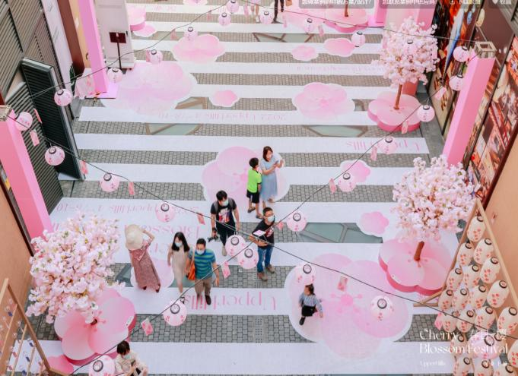
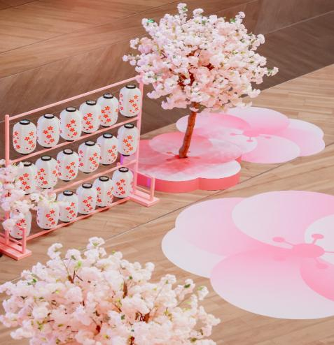
幸会樱花下主题合影区
SPRING IS COMING SPRING IS COMING SPRING IS COMING SPRING IS COMING
摆放花艺组景，营造浪漫温馨活动氛围，还可以在樱花树下，挂上心愿签把美好愿望永远铭刻在心里。
SPRING IS COMING SPRING IS COMING SPRING IS COMING SPRING IS COMING

Slide 13

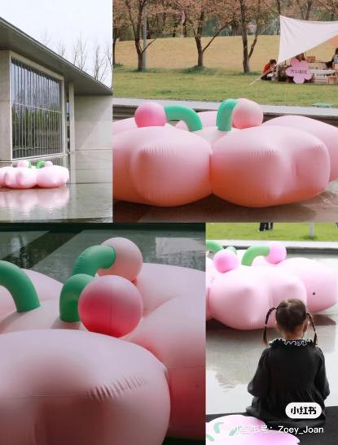
巨型樱花
SPRING IS COMING SPRING IS COMING SPRING IS COMING SPRING IS COMING
外场结合超大的樱花气模造型，增加活动的昭示性，增加传播噱头。
SPRING IS COMING SPRING IS COMING SPRING IS COMING SPRING IS COMING

Slide 14
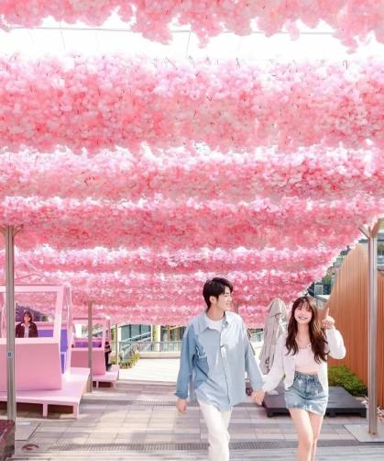
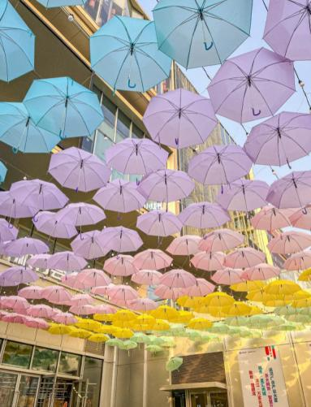
樱影漫境
SPRING IS COMING SPRING IS COMING SPRING IS COMING SPRING IS COMING
现场设置主题通道，在樱花隧道穿梭，空气中都是粉色的泡泡~
SPRING IS COMING SPRING IS COMING SPRING IS COMING SPRING IS COMING

Slide 15
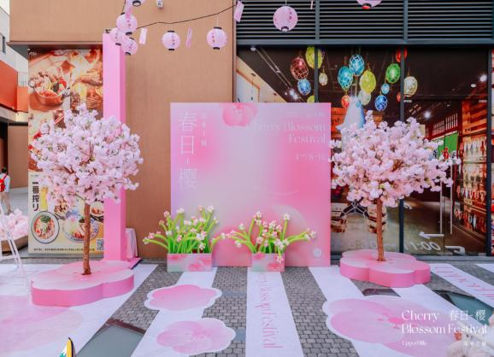
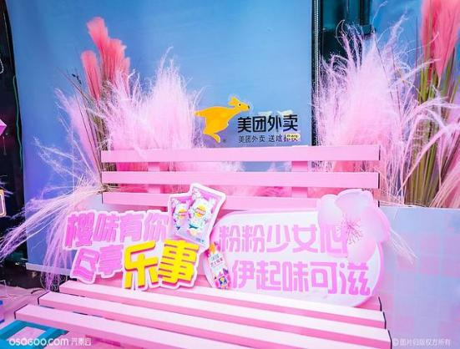
外场迎宾美陈区
SPRING IS COMING SPRING IS COMING SPRING IS COMING SPRING IS COMING
“樱花红陌上，杨柳绿池边”古往今来樱花都是春天里浪漫的期待！
SPRING IS COMING SPRING IS COMING SPRING IS COMING SPRING IS COMING

Slide 16
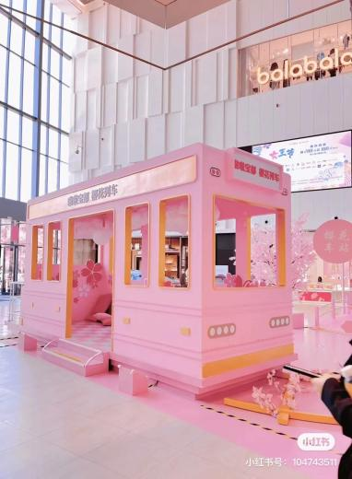
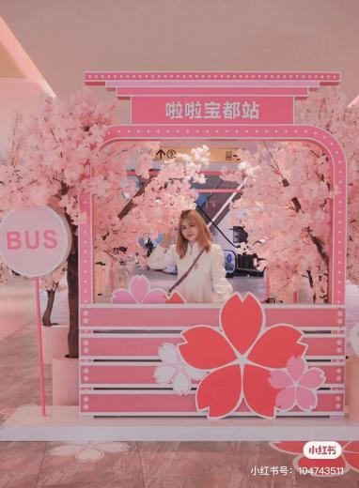
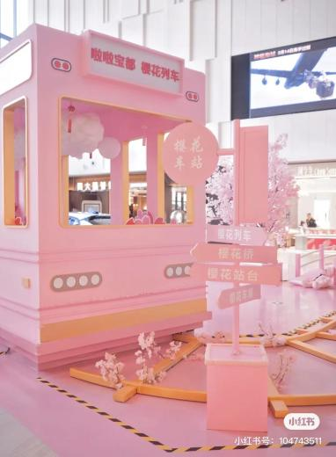
樱花列车主题合影区
SPRING IS COMING SPRING IS COMING SPRING IS COMING SPRING IS COMING
模拟列车的活动场景：候车厅、售票亭等等，这些位置都很适合拍照，超级出片。
SPRING IS COMING SPRING IS COMING SPRING IS COMING SPRING IS COMING

Slide 17
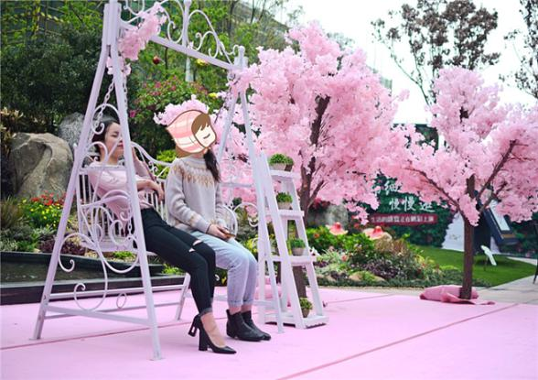
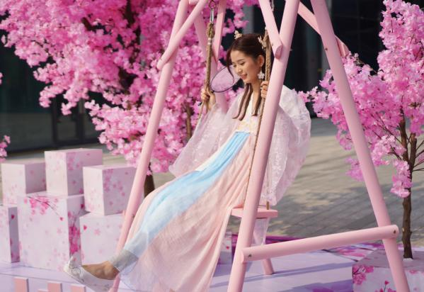
樱花秋千主题合影区
SPRING IS COMING SPRING IS COMING SPRING IS COMING SPRING IS COMING
现场布置樱花秋千，让观众感受到樱花的美好，也将樱花的转瞬即逝定格在这个春天。
SPRING IS COMING SPRING IS COMING SPRING IS COMING SPRING IS COMING

Slide 18
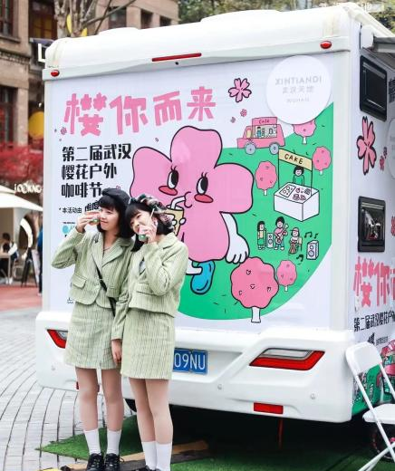
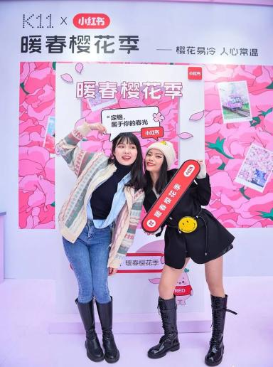
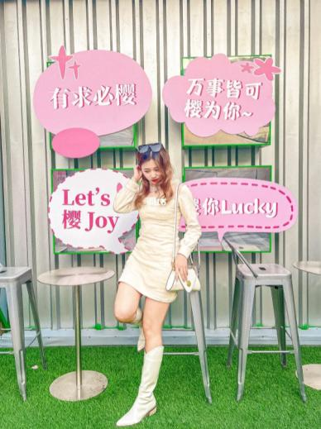
创意主题合影区
SPRING IS COMING SPRING IS COMING SPRING IS COMING SPRING IS COMING
SPRING IS COMING SPRING IS COMING SPRING IS COMING SPRING IS COMING

Slide 19
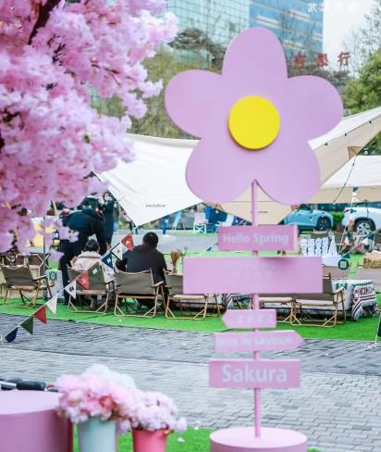
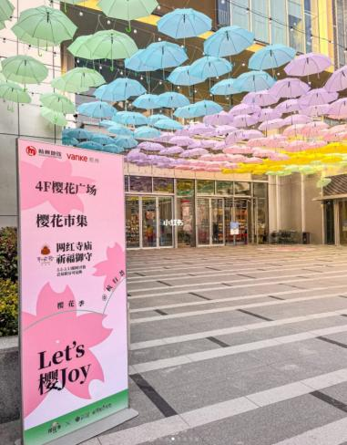
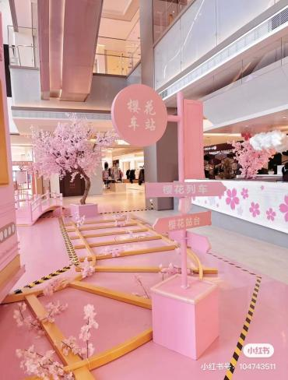
创意导视示意
SPRING IS COMING SPRING IS COMING SPRING IS COMING SPRING IS COMING
SPRING IS COMING SPRING IS COMING SPRING IS COMING SPRING IS COMING

Slide 20
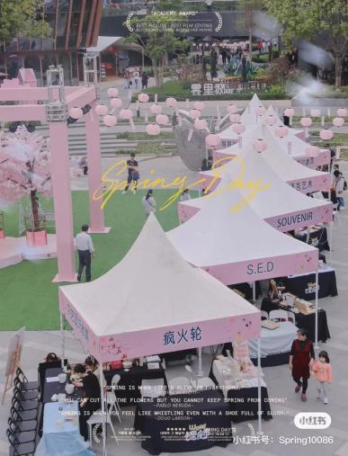
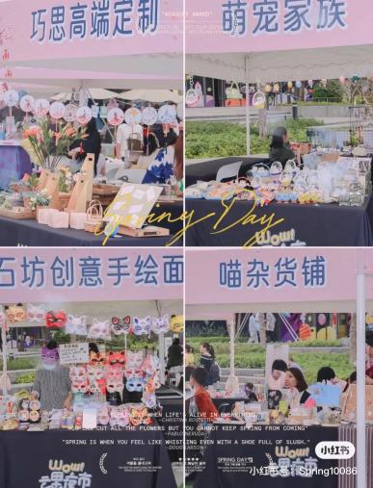
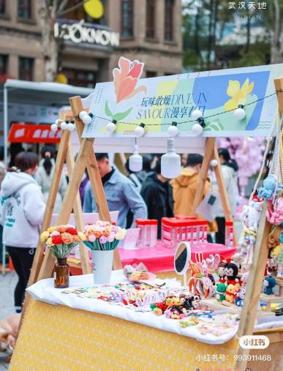
樱 JOY市集
SPRING IS COMING SPRING IS COMING SPRING IS COMING SPRING IS COMING
统一摊位包装，结合粉白色调装饰，增加樱花节氛围。
SPRING IS COMING SPRING IS COMING SPRING IS COMING SPRING IS COMING

Slide 21
SPRING IS COMING SPRING IS COMING SPRING IS COMING SPRING IS COMING
03
活动内容
LET`S 樱 JOY
2023年樱花节主题活动方案
SPRING IS COMING SPRING IS COMING SPRING IS COMING SPRING IS COMING

Slide 22
SPRING IS COMING SPRING IS COMING SPRING IS COMING SPRING IS COMING
Chapter 01
樱 JOY市集-春集
2023年樱花节主题活动方案
SPRING IS COMING SPRING IS COMING SPRING IS COMING SPRING IS COMING

Slide 23
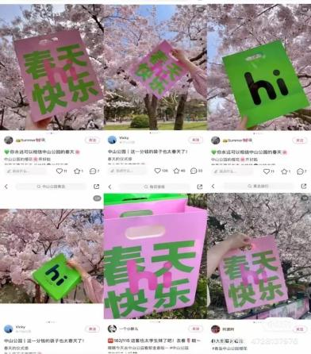
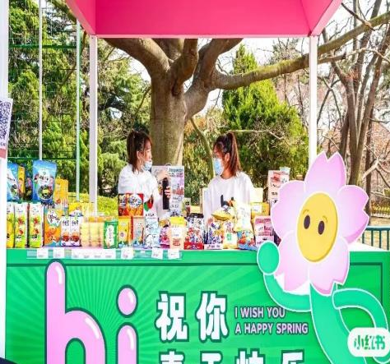
打包春天主题礼品区
SPRING IS COMING SPRING IS COMING SPRING IS COMING SPRING IS COMING
SPRING IS COMING SPRING IS COMING SPRING IS COMING SPRING IS COMING

Slide 24
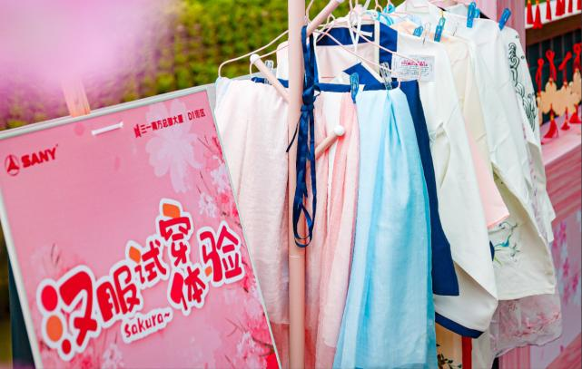
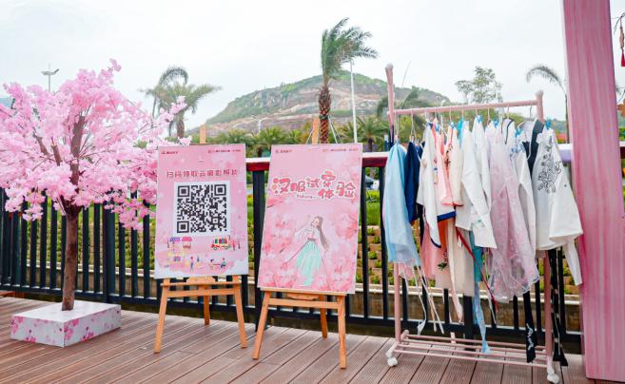
汉服体验区
SPRING IS COMING SPRING IS COMING SPRING IS COMING SPRING IS COMING
现场准备一些汉服，邀您赴一场樱花之约以樱花为景，身穿汉服打卡拍照，再回眸便已然是画中人
SPRING IS COMING SPRING IS COMING SPRING IS COMING SPRING IS COMING

Slide 25
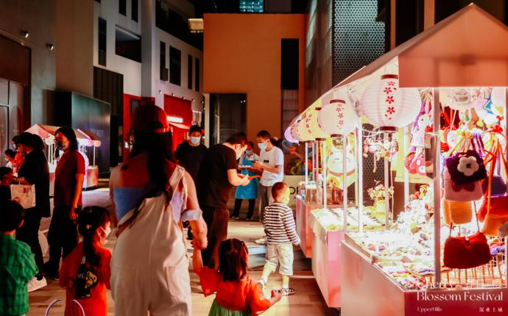
樱 JOY市集-春集
SPRING IS COMING SPRING IS COMING SPRING IS COMING SPRING IS COMING
把生活中美好的事物搜集一起，构建出一个粉色浪漫的庇护所，成为都市人解压玩乐、享受当下的休憩地。
SPRING IS COMING SPRING IS COMING SPRING IS COMING SPRING IS COMING

Slide 26
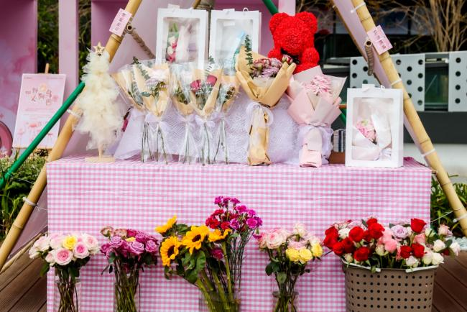
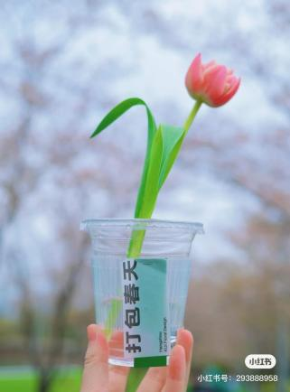
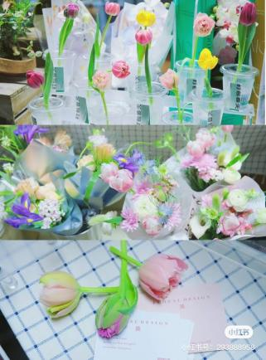
樱 JOY市集-限定花店
SPRING IS COMING SPRING IS COMING SPRING IS COMING SPRING IS COMING
现场准备超有春天感的花束，还有网红郁金香杯花出售，把花花拿捏住！轻松把春天打包回家！
SPRING IS COMING SPRING IS COMING SPRING IS COMING SPRING IS COMING

Slide 27
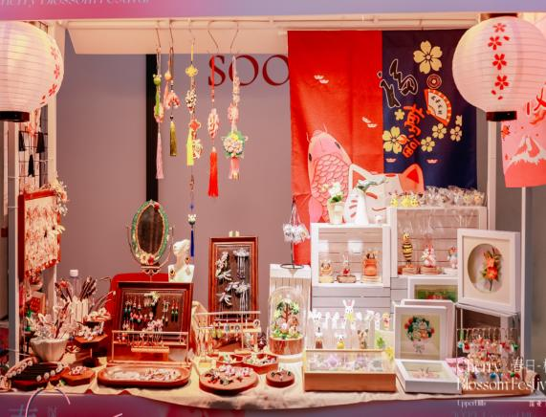
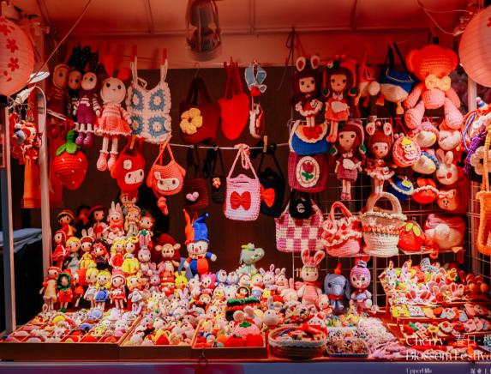
樱 JOY市集-手工艺术品
SPRING IS COMING SPRING IS COMING SPRING IS COMING SPRING IS COMING
手工编织的包包、耳环等小饰品，一个摊位就可以驻足半小时。
SPRING IS COMING SPRING IS COMING SPRING IS COMING SPRING IS COMING

Slide 28
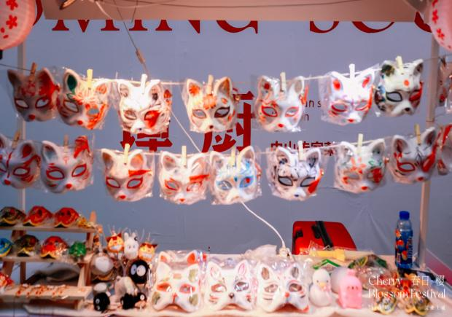
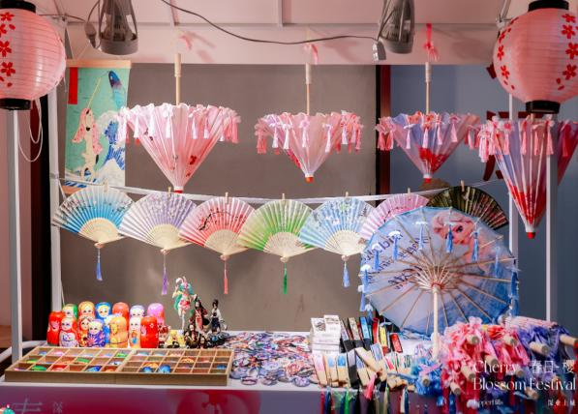
樱 JOY市集-扇子/面具
SPRING IS COMING SPRING IS COMING SPRING IS COMING SPRING IS COMING
古风扇子和面具的浪漫与乐趣不言而喻，穿上汉服，拿起道具，解锁不一样的樱花游园会。
SPRING IS COMING SPRING IS COMING SPRING IS COMING SPRING IS COMING

Slide 29
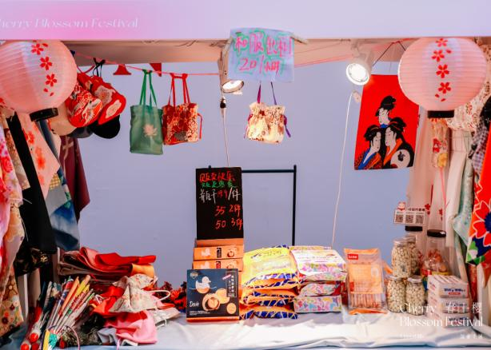
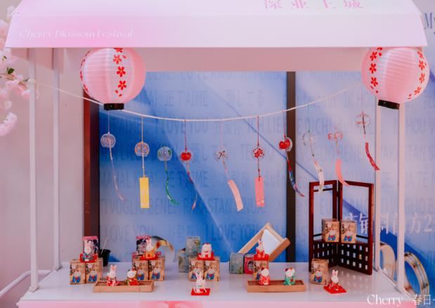
樱 JOY市集-手提袋/风铃
SPRING IS COMING SPRING IS COMING SPRING IS COMING SPRING IS COMING
樱花风铃和彩绘手提袋，真的很有氛围感，Get独一无二的扇子和包包，还能领取风铃挂在樱花树上
SPRING IS COMING SPRING IS COMING SPRING IS COMING SPRING IS COMING

Slide 30
SPRING IS COMING SPRING IS COMING SPRING IS COMING SPRING IS COMING
Chapter 01
樱运而生-祈福
2023年樱花节主题活动方案
SPRING IS COMING SPRING IS COMING SPRING IS COMING SPRING IS COMING

Slide 31

御守祈福主题区
SPRING IS COMING SPRING IS COMING SPRING IS COMING SPRING IS COMING
从古至今御守都被认为是"愿望"的象征。如果你也想拥有属于自己的御守，那就来这吧！挑选一个心仪的御守，扫去2022年发生的所有不好的事情，重新开始新的一年~
SPRING IS COMING SPRING IS COMING SPRING IS COMING SPRING IS COMING

Slide 32
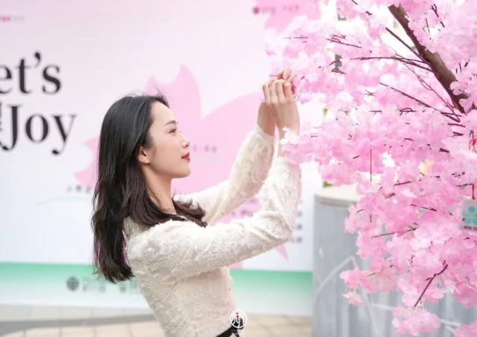
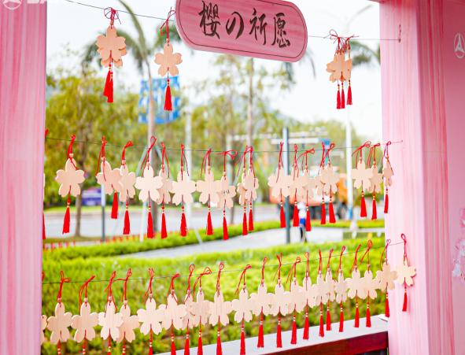
御守祈福主题区
SPRING IS COMING SPRING IS COMING SPRING IS COMING SPRING IS COMING
快拿出来挂在樱花树枝上吧！闭眼许愿，粉粉的花瓣飘落在淡淡春风里，多少美好心事涌上心头~
SPRING IS COMING SPRING IS COMING SPRING IS COMING SPRING IS COMING

Slide 33
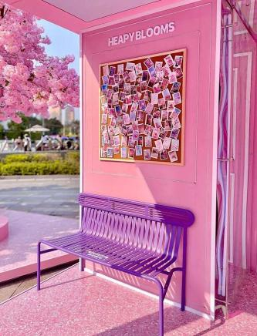
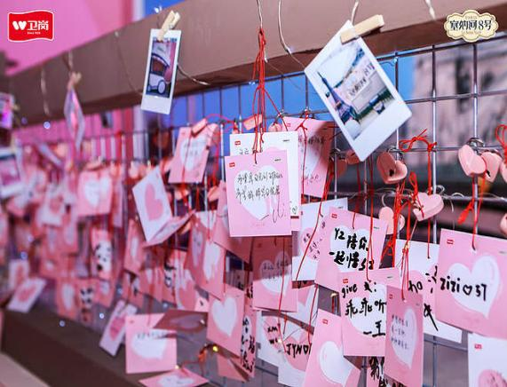

有樱必求互动区
SPRING IS COMING SPRING IS COMING SPRING IS COMING SPRING IS COMING
现场结合巴士站设置许愿区，现场领取明信片或心愿卡，写上自己的心愿，打造沉浸式互动打卡点，增加现场氛围。
SPRING IS COMING SPRING IS COMING SPRING IS COMING SPRING IS COMING

Slide 34
SPRING IS COMING SPRING IS COMING SPRING IS COMING SPRING IS COMING
Chapter 01
得心樱手-互动
2023年樱花节主题活动方案
SPRING IS COMING SPRING IS COMING SPRING IS COMING SPRING IS COMING

Slide 35


以樱之名盲盒墙
SPRING IS COMING SPRING IS COMING SPRING IS COMING SPRING IS COMING
现场准备各种樱花主题的惊喜礼品，设置盲盒墙，现场转发活动图片到朋友圈集赞，即可免费领取
SPRING IS COMING SPRING IS COMING SPRING IS COMING SPRING IS COMING

Slide 36


火烈鸟套圈
SPRING IS COMING SPRING IS COMING SPRING IS COMING SPRING IS COMING
现场签到，每人即可领取5个圈，套中即可获得印章。
SPRING IS COMING SPRING IS COMING SPRING IS COMING SPRING IS COMING

Slide 37

妙趣樱花球手
SPRING IS COMING SPRING IS COMING SPRING IS COMING SPRING IS COMING
现场签到，每人即可领取5个沙包，成功投中洞内，即可获得印章。
SPRING IS COMING SPRING IS COMING SPRING IS COMING SPRING IS COMING

Slide 38


插花艺术体验
SPRING IS COMING SPRING IS COMING SPRING IS COMING SPRING IS COMING
现场领取花艺材料包，在专业老师的指导下，来一场与鲜花的邂逅。
SPRING IS COMING SPRING IS COMING SPRING IS COMING SPRING IS COMING

Slide 39


樱花涂鸦体验
SPRING IS COMING SPRING IS COMING SPRING IS COMING SPRING IS COMING
现场设置创意涂鸦区，专业老师指导，进行樱花世界的创作。
SPRING IS COMING SPRING IS COMING SPRING IS COMING SPRING IS COMING

Slide 40



SPRING IS COMING SPRING IS COMING SPRING IS COMING SPRING IS COMING
得心樱手扭蛋机
根据打卡集章数，在此参与抽奖环节，最高还有苹果手机。
SPRING IS COMING SPRING IS COMING SPRING IS COMING SPRING IS COMING

Slide 41
SPRING IS COMING SPRING IS COMING SPRING IS COMING SPRING IS COMING
Chapter 01
樱火之声-春乐
2023年樱花节主题活动方案
SPRING IS COMING SPRING IS COMING SPRING IS COMING SPRING IS COMING

Slide 42

樱花主题巡游
SPRING IS COMING SPRING IS COMING SPRING IS COMING SPRING IS COMING
SPRING IS COMING SPRING IS COMING SPRING IS COMING SPRING IS COMING

Slide 43

浪漫樱花雨
SPRING IS COMING SPRING IS COMING SPRING IS COMING SPRING IS COMING
来宾在如梦似幻的光影世界如愿邂逅唯美樱花雨。
SPRING IS COMING SPRING IS COMING SPRING IS COMING SPRING IS COMING

Slide 44


樱火之声
SPRING IS COMING SPRING IS COMING SPRING IS COMING SPRING IS COMING
现场安排乐队为到场来宾演绎浪漫音乐，烘托现场氛围，增加节日的仪式感。
SPRING IS COMING SPRING IS COMING SPRING IS COMING SPRING IS COMING

Slide 45
SPRING IS COMING SPRING IS COMING SPRING IS COMING SPRING IS COMING
Chapter 01
樱JOY限定-美食
2023年樱花节主题活动方案
SPRING IS COMING SPRING IS COMING SPRING IS COMING SPRING IS COMING

Slide 46


限定美食摊位
SPRING IS COMING SPRING IS COMING SPRING IS COMING SPRING IS COMING
现场结合樱花布景，设置主题美食摊位，增加现场氛围的同时，准备多种樱花美食供大家品鉴。
SPRING IS COMING SPRING IS COMING SPRING IS COMING SPRING IS COMING

Slide 47

网红冰淇淋车
SPRING IS COMING SPRING IS COMING SPRING IS COMING SPRING IS COMING
网红冰淇淋车C位出道，限时提供樱花味冰淇淋，预感又要在小红书朋友圈掀起一阵粉色狂潮啦！
SPRING IS COMING SPRING IS COMING SPRING IS COMING SPRING IS COMING

Slide 48


樱花系列饮品
SPRING IS COMING SPRING IS COMING SPRING IS COMING SPRING IS COMING
既然是樱花节，当然少不了樱花主题美食啦！春天里，樱花树下，手捧美食的你制霸朋友圈！在游玩之时补充能量，元气满满哦！
SPRING IS COMING SPRING IS COMING SPRING IS COMING SPRING IS COMING

Slide 49


樱花下午茶
SPRING IS COMING SPRING IS COMING SPRING IS COMING SPRING IS COMING
到场的所有来宾进行美食品鉴交流，并邀请著名米其林星厨，现场制作樱花美食与来宾交流品鉴心得，带来视觉味觉双重享受体验。
SPRING IS COMING SPRING IS COMING SPRING IS COMING SPRING IS COMING

Slide 50
樱花布丁
SPRING IS COMING SPRING IS COMING SPRING IS COMING SPRING IS COMING
现在在专业甜点师的指导下，制作樱花口味的布丁，感受舌尖上的春天。
SPRING IS COMING SPRING IS COMING SPRING IS COMING SPRING IS COMING

Slide 51


樱花系列饮品
SPRING IS COMING SPRING IS COMING SPRING IS COMING SPRING IS COMING
现场集限定饮品拼图，集齐樱花造型拼图，即可领取麦当劳限定款樱花气泡饮料。
SPRING IS COMING SPRING IS COMING SPRING IS COMING SPRING IS COMING

Slide 52
谢谢观看
2023地产项目春天樱花节主题活动
#2023
Spring Day

